Slide 1
Best-in-class patient setup
Instructor-led training
60 minutes
+
5 minutes per role play
Notes:
Hello Facilitator!
A few things to remember about using this power point:
This is both a guide for yourself and for the learner. The majority of discussions should be carried by those in class
There are a series of text boxes within the PowerPoint: these should be used frequently to list down discussion points (has to be in presentation mode!)
All materials referenced within this learning will be available to you- no surprises here!

Slide 2
How YOU can make this a valuable session for all
Help each other
Participate in discussions
Be open-minded but also honest regarding what has/hasn’t worked for you in the past
Don’t be afraid of role plays – this is a safe learning environment!

Slide 3

Thoughts on Best-in-class patient setup video
TODAY’S AGENDA
Rate your confidence
Step-by-step review of patient setup checklist
Practice time
Action plan
Notes:
Present the agenda on slide.
Things to remember:
Have each learner sign the attendance roster.
With a quiet group, it is good to have probing questions ready to begin the discussion.
Remind the class that it is OKAY to feel unconfident; it is better to speak up now than to be confused later.
Encourage peer discussion. If two learners engage in a relevant dialogue on a subject, let them “lead” the learning with said dialogue.

Slide 4
Thoughts on
Best-in-class patient setup video
Let’s discuss!
Notes:
Prerequisite: Learners must have watched the video demonstration in order to attend instructor-led session.
Facilitate a 2-3 minute discussion to gather thoughts and opinions on the patient setup video demonstration.

Slide 5
Importance of a good patient setup
What do you believe?
Raise your hand
Do you feel that the patient setup appointment has an impact on a patient’s success rate with therapy?
Notes:
Before we get into talking about each step of the checklist, let’s discuss the importance of a good patient setup for a moment.

Slide 6
Importance of a good patient setup
What could go wrong?
  Patient is unsure of why therapy is important
  Patient doesn’t adhere to therapy
  Patient becomes frustrated with therapy
  Patient doesn’t use therapy correctly
    Mask worn incorrectly
    Humidifier tub missing water
    Low nightly therapy use (E.g. only 1-2 hours per night)
  Patient ends up with a mask that doesn’t suit them
  More follow-up with the patient is required
  Patient is unsure of where to turn when issues arise

Slide 7
Rate your confidence

Slide 8
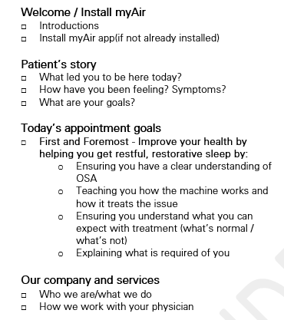
Confidence ratings (3 each)
= I feel very confident in this area
= I could use some help in this area
Notes:
Provide each participant with a copy of the checklist (if they don’t already have one) and have them put a star beside 3 topics they feel very confident in reviewing with patients. Have them put a triangle beside 3 topics they feel they could be better at. Have them write directly on the paper itself. This will be used later in the session. If necessary, re-assure them that it’s for their own reference purposes.

Slide 9
Step-by-step review of the patient checklist

Slide 10
Multi-use checklist
The checklist is meant for both yourself and the patient.
The patient should receive a copy to take home to help refresh them on everything you covered.
Either check items off yourself or have the patient do it to keep them engaged.
Notes:
We’re going to spend the next 60 minutes going over each section of the checklist.

Slide 11

Welcome / Install myAir
What can we tell the patient to convince them to install myAir?
Notes:
Suggested responses from learners:
It will help keep them motivated with therapy
It’s a 24/7 coach there to help them whenever they need
It’s very easy to use once installed
They’re missing out if they don’t use it along with their machine

Slide 12
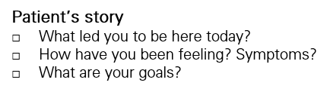
Patient’s story
Why is it important that we cover this section? What are we hoping to get out of the patient?
Notes:
For example the patient may say that:
They don’t have any energy throughout the day.
They’ve experienced significant weight gain.
They’re afraid of long-term effects of sleep apnea.
Their significant other wants them to stop snoring.
They’re worried about their job as they cannot focus anymore.
In regards to goals, we’re looking for the patient to articulate things like:
Being more focused at work
Being able to go for a walk and play with kids
Feeling rested in the morning
Talk to the patient about the reality of achieving expected results and the length of time it may take (it may not be an overnight improvement).

Slide 13
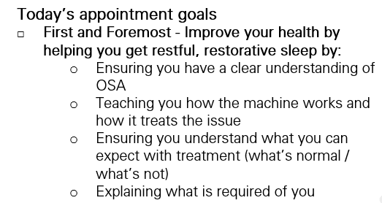
Today’s appointment goals
What do you think the benefit is to explaining your goals to the patient are?
Notes:
Suggested responses from learners:
It helps build the relationship with the patient.
It lets the patient know that we care about their health.
It lets the patient know what to expect out of today’s appointment.
It helps put the patient’s mind at ease about the appointment.

Slide 14

Our company and services
What could we cover in this section?
Notes:
Suggested responses from learners:
We are your home equipment provider (and what that means exactly)
We will help set you up on therapy
Answer any questions you have
Monitor your progress on therapy
Manage the billing for the machine through your insurance provider
Help you replace parts when necessary
Will be your biggest cheerleader to help you succeed
This is not a time to:
Talk about how many locations you have nationwide
Explain how you’re better than another HME in the area
Explain the history of your company
Provide a detailed explanation of services your company has to offer (description of any other services should be brief and can even be in pamphlet form if available)

Slide 15
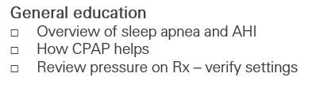
General education
What items would you cover when providing a sleep apnea overview?
Notes:
Suggested responses from learners:
***Note: If learners start to talk about CPAP therapy, tell them to hold their comments until the next slide
The importance of good sleep / Your body needs a certain amount of sleep to restore / consequences of not having good sleep
What sleep apnea is
Use visuals to demonstrate OSA (ResMed Facts and Figures handout, etc.)
The difference between OSA and CSA
Explain applicable key terms related to sleep apnea including:
AHI
OSA

Slide 16
General education (continued)
How would you go about explaining how CPAP can help?
Notes:
Suggested responses from learners:
Explain what positive airway pressure is and how it is used to splint the airway open.
Explain how every patient requires a certain level of pressure depending on their type and severity of sleep apnea.
It’s most effective when used for at least 4 hours per night.

Slide 17
General education (continued)
What approach would you take in explaining a patient’s Rx pressure setting?
Notes:
Suggested responses from learners:
I would show the patient the settings listed on the Rx and indicate that this was determined based on their sleep study.
I would explain that the machine will provide this prescribed level of pressure constantly (if on CPAP) or will auto-adjust based on what they need (if on APAP).
I would explain how this is a prescribed setting that only a medical professional can change as it could negatively impact sleep otherwise.

Slide 18
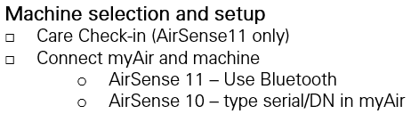
Using myAir during setup
How do you think introducing and using myAir during the appointment helps the patient?
Notes:
Suggested responses from learners:
The patient will know where to go for help when they get home
It helps keep the appointment structured by following myAir’s setup steps
You can be certain the patient doesn’t have any issues downloading or registering for it

Slide 19
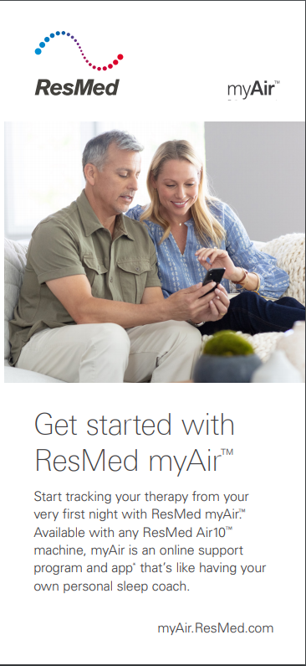
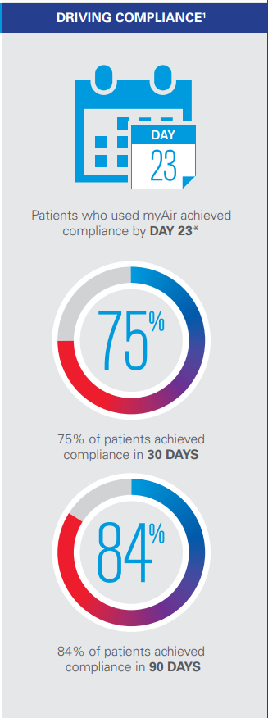
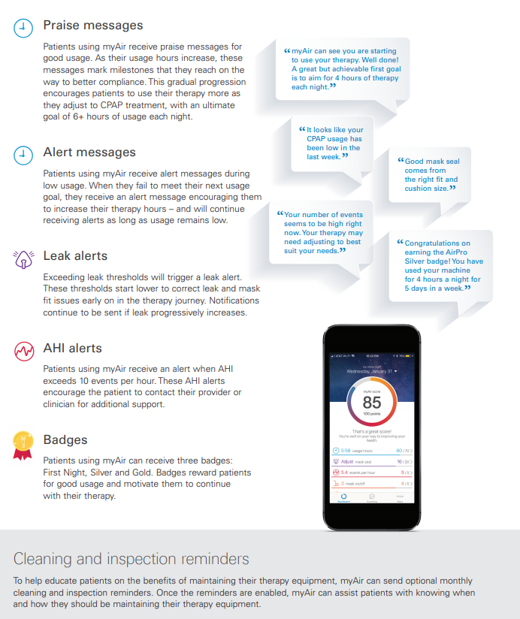
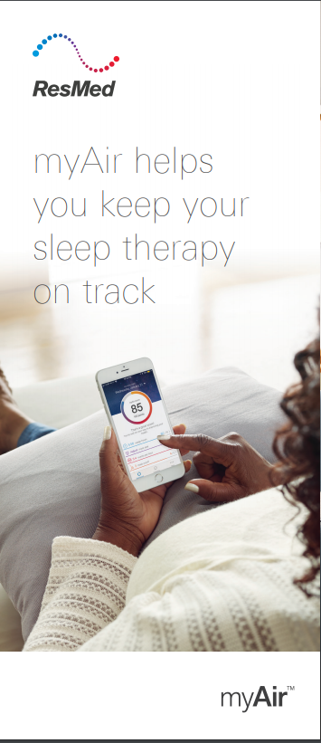
myAir
Notes:
Explain to learners that there are ResMed resources that can be provided to patients to encourage them to sign up if they don’t want to during the appointment itself.

Slide 20
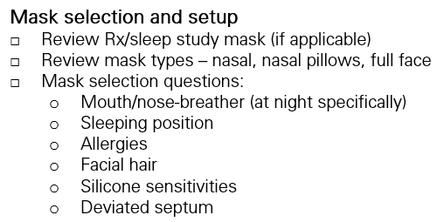
Mask selection and setup
What are the consequences of not selecting the right mask?
Notes:
Mask fitting and type per patient is the #1 cause of non-compliance!
Managing leaks, comfort, sizing, and understanding how to put on and tighten the mask are paramount. Make sure the patient has a chance to feel the mask and try it out!
Suggested responses from learners:
Choosing the wrong mask may cause non-compliance.
Patient will be calling back for re-fit appointments more often
Higher cost due to returned masks
Patient will become frustrated with therapy and may abandon it completely.
Patient may experience side effects such as: mask leak, skin rashes, claustrophobia, etc.

Slide 21

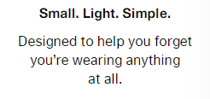



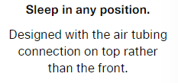





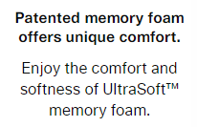



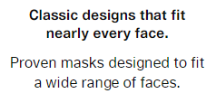


Simplifying mask selection
Scenarios |  | Mask profile | I’d recommend …
 | I’m new to therapy. I sleep on my stomach and I don’t want to wear anything too bulky. I breathe through my nose.
 | I often grow a beard and breathe through my mouth.
 | I often suffer from a stuffy nose due to my seasonal allergies. I also want something that fits really well from Day one.
 | I have dexterity issues and so I need something simple and lightweight. I breathe through my nose.
 | I breathe through my mouth but I don’t like the look of the full face masks. They make me feel claustrophobic. I also like to read at night and wear reading glasses.
AirFit N30i
AirFit P30i
AirTouch F20
AirFit F20
AirFit P10
AirFit N30
AirFit F30
Notes:
Allow learners the opportunity to determine the best mask for the patient using.

Slide 22
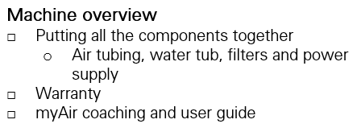
Machine overview
When conducting a CPAP machine overview, what elements are important to cover?
Notes:
Keep it simple. ResMed’s machines are very easy to put together.
Suggested responses from learners:
How to put components together
How to install and use myAir
The benefits of myAir
Key LED screen options
The importance of using distilled water
Where to find the filters
It’s important that the patient learns the basics: how to turn on the machine and how to fill their water chamber.
myAir can be a great tool for supplementing patient education - think of myAir as your assistant coach.

Slide 23

Test drive
What are the key objectives to having a patient try out their machine during the appointment?
Notes:
Suggested responses from learners:
To encourage patients to ask you questions if they’re stuck (easier to do in-person than on the phone later)
To ensure the mask is fitted properly and to provide advice if there are leaks
To confirm that they are able to setup the machine once they get home
Practice encourages behavior

Slide 24
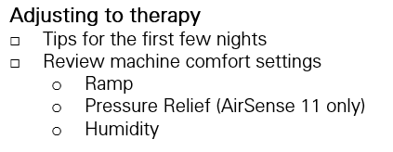
Adjusting to therapy
What sort of tips could you provide a patient to help them with their first few nights of therapy?
Notes:
Suggested responses from learners:
Wear it for 30 minutes while reading a book or watching TV to get used to the mask.
Show it off to family members in your household. Be proud that you’re taking ownership of your health.
Use myAir for assistance; it has a great FAQ section and its instructional videos are based strictly on the ResMed mask you’ve been provided.
Run mask fit if you are experiencing a mask leak.
Lead up to more and more time each night. Set yourself increasing goals each night for use.

Slide 25
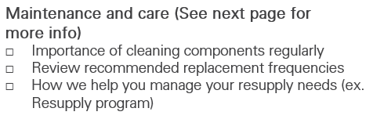
Maintenance and care
What is important to tell the patient regarding proper equipment maintenance?
Notes:
Suggested responses from learners:
Using a mild soap
Pointing out the recommended frequency of cleaning (on back of checklist and in mask user guide)
Cleaning your CPAP machine will ensure these bacteria and mold are cleaned before they can adversely impact your health.
Explaining that improper cleaning may lead to certain consequences:
Rash or infection on the skin
Less effective treatment (over time)
Using an ozone cleaner is not a sufficient method for cleaning CPAP equipment.
Damage to your ResMed machine caused by using an ozone disinfectant device will not be covered by ResMed's limited warranty
Hanging tubing up over a shower rod to dry it
Working mask and accessory cleaning into your regular morning routine.
Having a standard place set up to put cleaned equipment each morning.

Slide 26

Compliance / Therapy Adherence
Why is it so important for a patient to adhere to compliance? What happens if they do not?
Notes:
Suggested responses from learners:
If they don’t adhere to therapy:
They won’t experience the benefits of therapy (typically at least 4 hours of therapy per night is required to notice any benefit)
(If applicable) Their insurance company won’t pay for the machine which means they’ll have to pay out of pocket or forfeit the device after a certain period of time.

Slide 27
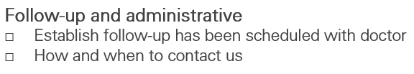
Follow-up and administrative
Why is this important to set the stage for follow-up?
Notes:
Suggested responses from learners:
It holds the patient accountable for their therapy, knowing that their physician will want to check up on their progress.
In certain cases, physician follow-up is required for reimbursement.

Slide 28
Break time!
After break, it will be time to practice what you’ve learned
Notes:
Using the checklist from earlier in the session, have learners choose an element from the checklist to role play/practice. It must be an area that they’ve rated with a triangle (low confidence level). As a trainer, use the Performance Evaluation checklist to assess their skill level. Your ResMed sales rep may be able to help you facilitate these role plays.
Assure learners that this is not a formal review and is for learning purposes and feedback only.

Slide 29
Practice time
Only focusing on elements you wish to practice
Notes:
Using the checklist from earlier in the session, have learners choose an element from the checklist to role play/practice. It must be an area that they’ve rated with a triangle (low confidence level). As a trainer, use the Performance Evaluation checklist to assess their skill level. Your ResMed sales rep may be able to help you facilitate these role plays.
Assure learners that this is not a formal review and is for learning purposes and feedback only.

Slide 30
How we do things – Let’s tie in our process
Some process points to consider:
How do we prepare a patient for their upcoming setup?
Who is responsible for monitoring a patient’s ongoing therapy and compliance?
Who is responsible for ensuring the patient has all the supplies they need?
How do we accomplish this?
Notes:
Use this slide to tie in some of your processes surrounding the patient setup appointment so that everything makes sense to the learner. For example:
Do you encourage the patient to download the myAir app before they even arrive for the appointment?
Do you recommend that they download the HelloSleep app (iOS only) in advance?
Is there anything else you do prior to the patient setup appointment?
Are there any processes you follow after the patient leaves?

Slide 31
What’s next?

Slide 32
Let’s keep it going: learning after today
Coaching
Reference material
Social learning
Video demo
Your learning is still not complete here today.
I will be coaching you periodically over the next few weeks to help you implement this new approach.
We took a lot of good notes today that you will have at your disposal. Use them as a guide whenever you need extra help.
I encourage you to meet with colleagues to talk about how it’s going. Share insights, tips and tricks.
Feel free to revisit the video demo at anytime to refresh your memory on how you could do certain sections.

Slide 33
Action plan
Holding yourself accountable
Notes:
Ask learners to:
retrieve their Action plan (have extra copies available just in case).
initial any components of the program they’ve already completed.
Hold themselves accountable to complete any outstanding components within a specified time period.

